Slide 1

Advanced NLP (Transformers – Bag 1)
NLP
Dr. Sajarwo Anggai, S.ST., M.T. NIDN : 0421108703

Slide 2
NLP Pipeline
Text Preprocessing
Feature Extraction
Modeling
Post-Processing
Deployment
Segmentation/ Tokenization
Normalization/ Lowercasing
Stopword Removal
Punctuation Removal
Stemming/ Lemmatization
Depedency parsing
Part-of-Speech Tagging
Bag of Words (BoW)
TF-IDF
Word Embeddings
Machine Learning
Deep Learning
Prediction
Evaluation
Fine-Tuning
Production
Monitoring and Updating

Slide 3
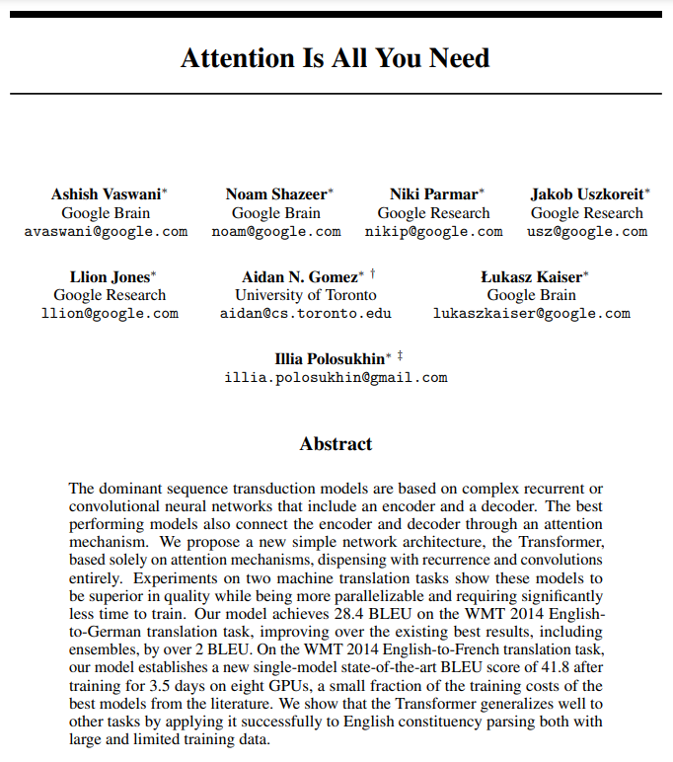
https://arxiv.org/pdf/1706.03762

Slide 4
Transformers
Apa Itu Transformers ?
Model transformers dalam deep learning adalah arsitektur jaringan saraf yang dirancang untuk menangani data berurutan dengan cara yang efisien dan paralel, terutama data dalam bentuk teks, yang berupa urutan token atau vector, melalui serangkaian lapisan yang berisi mekanisme self-attention dan jaringan saraf feedforward.
Refrensi : https://www.ibm.com/topics/transformer-model

Slide 5
Two big innovations
There are two primary innovations that transformer models bring to the table. Consider these two innovations within the context of predicting text.
Positional encoding: Instead of looking at each word in the order that it appears in a sentence, a unique number is assigned to each word.
Self-attention: Attention is a mechanism that calculates weights for every word in a sentence as they relate to every other word in the sentence, so the model can predict words which are likely to be used in sequence.
Refrensi : https://www.ibm.com/topics/transformer-model

Slide 6
Core Idea
Transformer models work by processing input data, which can be sequences of tokens or other structured data, through a series of layers that contain self-attention mechanisms and feedforward neural networks. The core idea behind how transformer models work can be broken down into several key steps.
Input Embedding
Positional Encoding
Multi-head Attention
Normalization & Residual Connection
Feedforward Neural Network
Stacked Layer
Output Layer
Training
Inference
Refrensi : https://www.ibm.com/topics/transformer-model

Slide 7
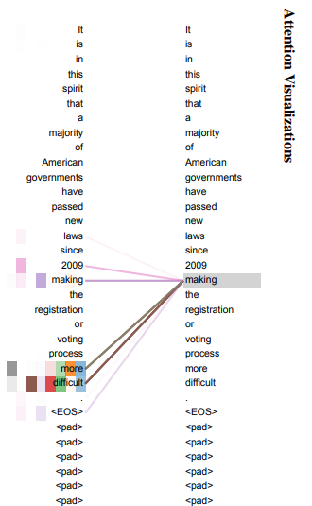
Core Idea
An example of the attention mechanism following long-distance dependencies in the encoder self-attention in layer 5 of 6. Many of the attention heads attend to a distant dependency of the verb ‘making’, completing the phrase ‘making...more difficult’. Attentions here shown only for the word ‘making’. Different colors represent different heads. Best viewed in color.
Refrensi : https://arxiv.org/pdf/1706.03762

Slide 8
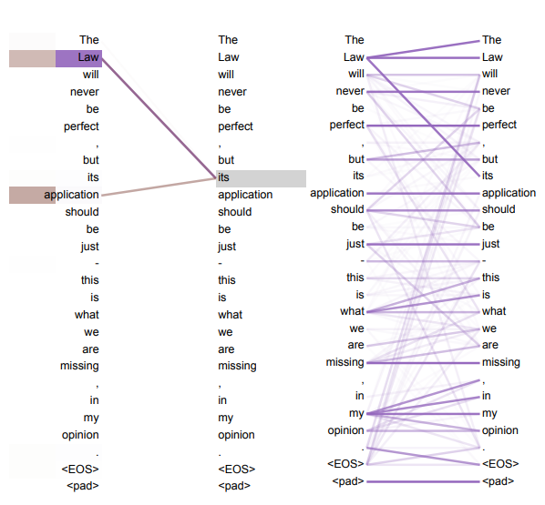

Slide 9
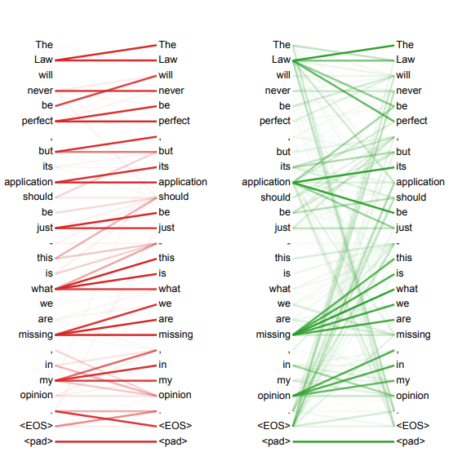

Slide 10

Komponen
Refrensi : https://neptune.ai/blog/bert-and-the-transformer-architecture/

Slide 11
Komponen
Each of these parts can be used independently, depending on the task:
Encoder-only models: Good for tasks that require understanding of the input, such as sentence classification and named entity recognition.
Decoder-only models: Good for generative tasks such as text generation.
Encoder-decoder models or sequence-to-sequence models: Good for generative tasks that require an input, such as translation or summarization.
Refrensi : https://aws.amazon.com/what-is/transformers-in-artificial-intelligence/

Slide 12
Komponen
The Transformer architecture was originally designed for translation. During training, the encoder receives inputs (sentences) in a certain language, while the decoder receives the same sentences in the desired target language. In the encoder, the attention layers can use all the words in a sentence (since, as we just saw, the translation of a given word can be dependent on what is after as well as before it in the sentence). The decoder, however, works sequentially and can only pay attention to the words in the sentence that it has already translated (so, only the words before the word currently being generated). For example, when we have predicted the first three words of the translated target, we give them to the decoder which then uses all the inputs of the encoder to try to predict the fourth word.
Refrensi : https://aws.amazon.com/what-is/transformers-in-artificial-intelligence/

Slide 13
Transformers are language models
All the Transformer models mentioned above (GPT, BERT, BART, T5, etc.) have been trained as language models. This means they have been trained on large amounts of raw text in a self-supervised fashion. Self-supervised learning is a type of training in which the objective is automatically computed from the inputs of the model. That means that humans are not needed to label the data!
An example of a task is predicting the next word in a sentence having read the n previous words. This is called causal language modeling because the output depends on the past and present inputs, but not the future ones.
Refrensi : https://aws.amazon.com/what-is/transformers-in-artificial-intelligence/

Slide 14
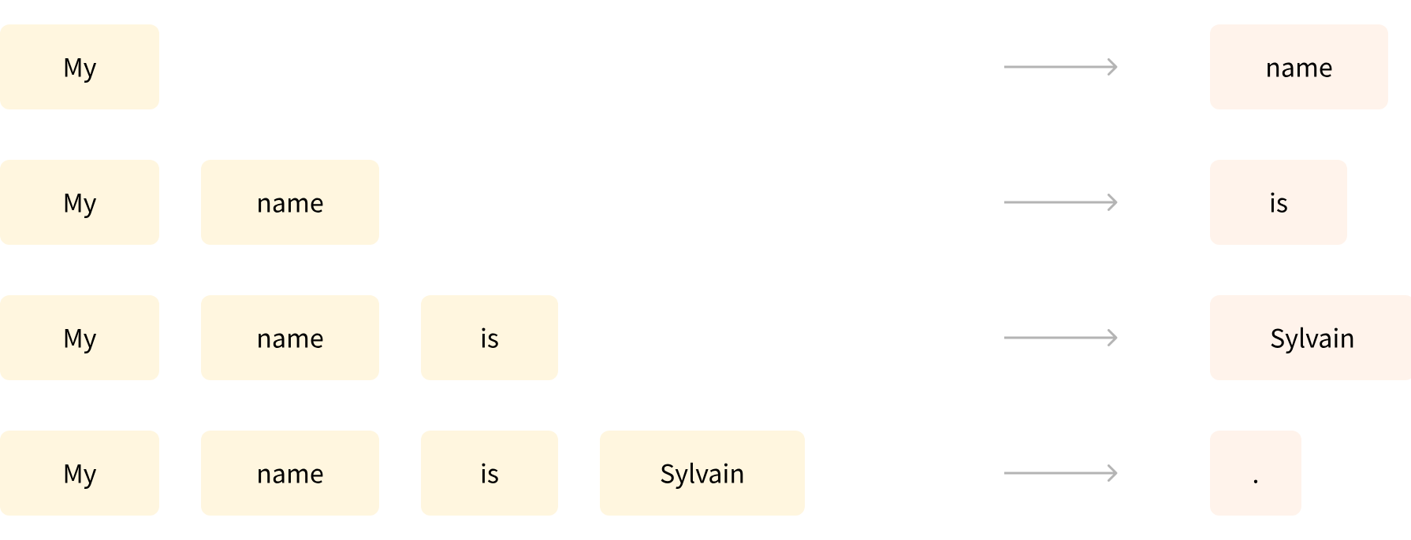
Transformers are language models
Refrensi : https://aws.amazon.com/what-is/transformers-in-artificial-intelligence/

Slide 15
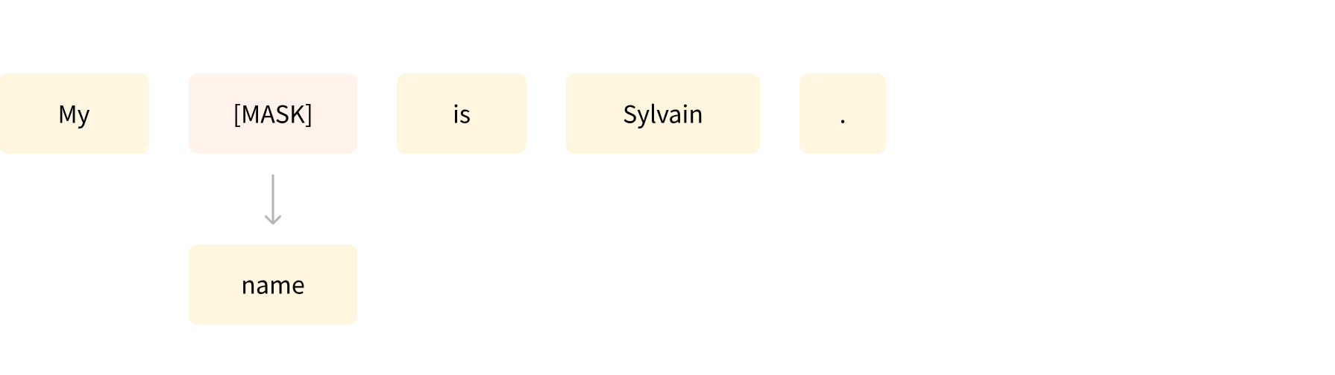
Transformers are language models
Another example is masked language modeling, in which the model predicts a masked word in the sentence.
Refrensi : https://aws.amazon.com/what-is/transformers-in-artificial-intelligence/

Slide 16
Transformers are language models
Refrensi : https://aws.amazon.com/what-is/transformers-in-artificial-intelligence/

Slide 17
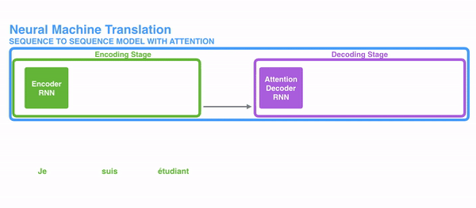
Transformers are language models
Refrensi : https://towardsdatascience.com/transformers-141e32e69591

Slide 18
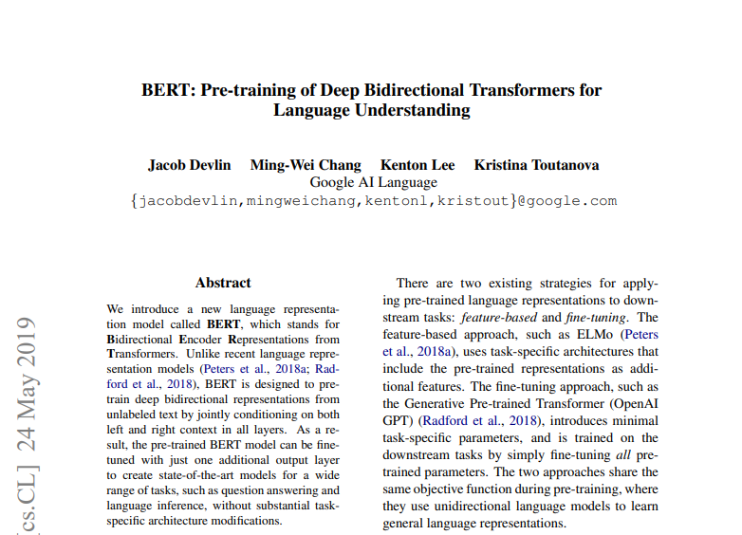
BERT
Refrensi : 1810.04805

Slide 19
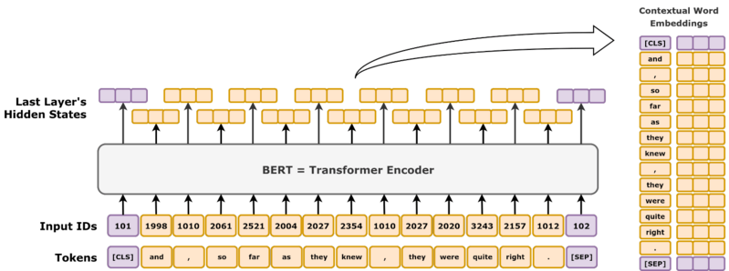
BERT
Bidirectional encoder representations from transformers (BERT) is a language model introduced in October 2018 by researchers at Google. It learns to represent text as a sequence of vectors using self-supervised learning. It uses the encoder-only transformer architecture. It is notable for its dramatic improvement over previous state-of-the-art models, and as an early example of a large language model. As of 2020, BERT is a ubiquitous baseline in natural language processing (NLP) experiments.
Refrensi : https://en.wikipedia.org/wiki/BERT_(language_model)

Slide 20
Bidirectional Approach of BERT
Model bahasa tradisional memproses teks secara berurutan, baik dari kiri ke kanan atau dari kanan ke kiri. Metode ini membatasi mekanisme pada konteks langsung sebelum kata target. BERT menggunakan pendekatan dua arah yang mempertimbangkan konteks kiri dan kanan kata dalam sebuah kalimat. Alih-alih menganalisis teks secara berurutan, BERT melihat semua kata dalam sebuah kalimat secara bersamaan.
Refrensi : https://www.geeksforgeeks.org/explanation-of-bert-model-nlp/

Slide 21
Bidirectional Approach of BERT
Example: “The bank is situated on the _______ of the river.”
In a unidirectional model, the understanding of the blank would heavily depend on the preceding words, and the model might struggle to discern whether “bank” refers to a financial institution or the side of the river.
BERT, being bidirectional, simultaneously considers both the left (“The bank is situated on the”) and right context (“of the river”), enabling a more nuanced understanding. It comprehends that the missing word is likely related to the geographical location of the bank, demonstrating the contextual richness that the bidirectional approach brings.
Refrensi : https://www.geeksforgeeks.org/explanation-of-bert-model-nlp/

Slide 22
Pre-training and Fine-tuning
The BERT model undergoes a two-step process:
Pre-training on Large amounts of unlabeled text to learn contextual embeddings.
Fine-tuning on labeled data for specific NLP tasks.
Pre-Training on Large Data : BERT is pre-trained on large amount of unlabeled text data. The model learns contextual embeddings, which are the representations of words that take into account their surrounding context in a sentence.
Refrensi : https://www.geeksforgeeks.org/explanation-of-bert-model-nlp/

Slide 23
Pre-training and Fine-tuning
Fine-Tuning on Labeled Data : After the pre-training phase, the BERT model, armed with its contextual embeddings, is then fine-tuned for specific natural language processing (NLP) tasks. This step tailors the model to more targeted applications by adapting its general language understanding to the nuances of the particular task.
BERT is fine-tuned using labeled data specific to the downstream tasks of interest. These tasks could include sentiment analysis, question-answering, named entity recognition, or any other NLP application. The model’s parameters are adjusted to optimize its performance for the particular requirements of the task at hand.
BERT’s unified architecture allows it to adapt to various downstream tasks with minimal modifications, making it a versatile and highly effective tool in natural language understanding and processing.
Refrensi : https://www.geeksforgeeks.org/explanation-of-bert-model-nlp/

Slide 24
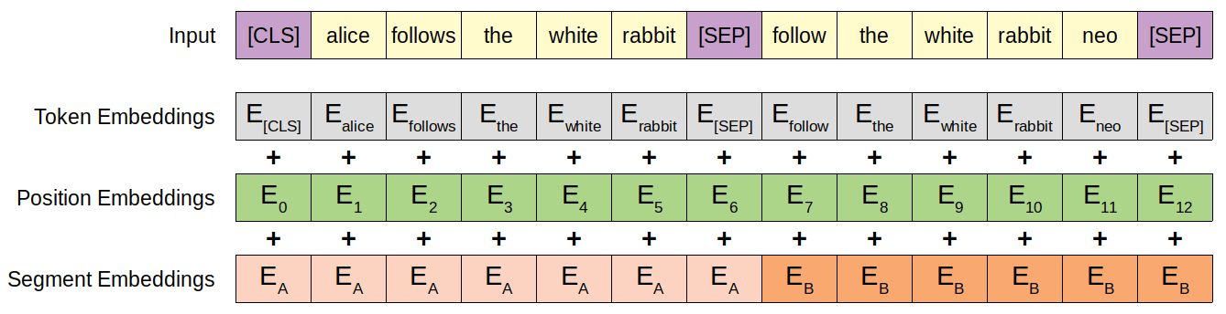
BERT Embedding
The three embedding vectors are added together representing the initial token representation as a function of these three pieces of information. After embedding, the vector representation is normalized using a LayerNorm operation, outputting a 768-dimensional vector for each input token. After this, the representation vectors are passed forward through 12 Transformer encoder blocks, and are decoded back to 30,000-dimensional vocabulary space using a basic affine transformation layer.
Refrensi : https://en.wikipedia.org/wiki/BERT_(language_model)

Slide 25
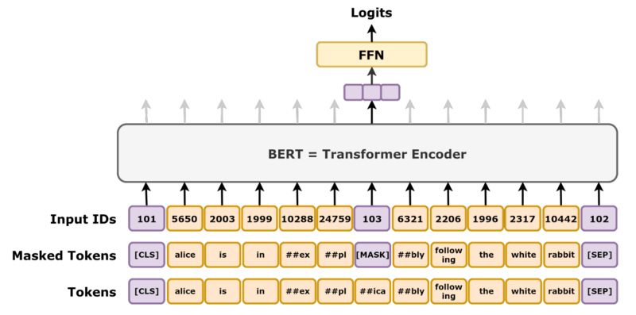
Masked Language Modelling Task
Refrensi : https://en.wikipedia.org/wiki/BERT_(language_model)

Slide 26
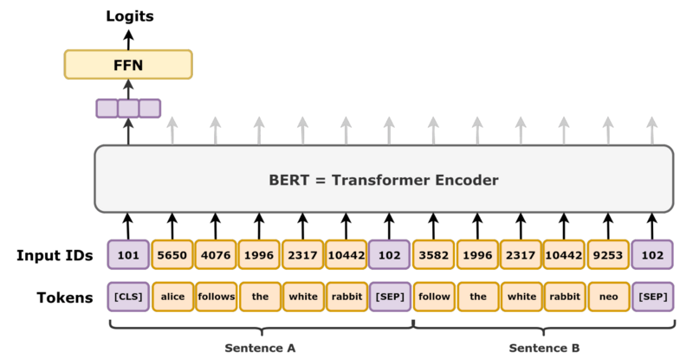
Next Sequence Prediction Task
Refrensi : https://en.wikipedia.org/wiki/BERT_(language_model)

Slide 27
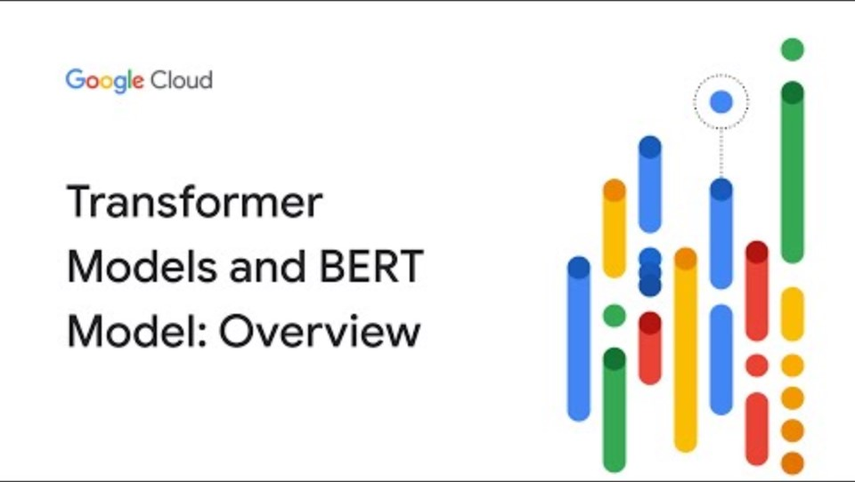
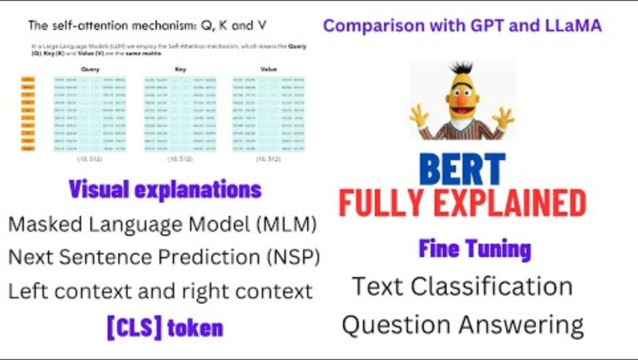
Treansformer Models

Slide 28
BERT
Aplikasi BERT digunakan untuk:
Representasi Teks
Pengenalan Entitas Bernama (NER)
Klasifikasi Teks
Sistem Tanya Jawab
Terjemahan Mesin.
Ringkasan Teks.
Conversational AI
Semantic Similarity
Refrensi : https://www.geeksforgeeks.org/explanation-of-bert-model-nlp/

Slide 29
Percobaan Transformer untuk Sentiment 1. Import Library dan data yang akan digunakan (menggunakan torch sebagai library)
pip install transformers torch
from transformers import BertConfig, BertModel

Slide 30
2. Membuat Model Transformers
model_type = "bert"
def __init__(
self,
vocab_size=30522,
hidden_size=768,
num_hidden_layers=12,
num_attention_heads=12,
intermediate_size=3072,
hidden_act="gelu",
hidden_dropout_prob=0.1,
attention_probs_dropout_prob=0.1,
max_position_embeddings=512,
type_vocab_size=2,
initializer_range=0.02,
layer_norm_eps=1e-12,
pad_token_id=0,
gradient_checkpointing=False,
kwargs
):
Notes:
https://huggingface.co/transformers/v3.0.2/_modules/transformers/configuration_bert.html#BertConfig

Slide 31
Penjelasan Parameter
vocab_size (30522): Jumlah token unik dalam kosakata model.
hidden_size (768): Dimensi representasi atau vektor keluaran dari setiap lapisan.
num_hidden_layers (12): Jumlah lapisan encoder dalam BERT.
num_attention_heads (12): Jumlah kepala perhatian (*attention heads*) dalam mekanisme multi-head attention.
intermediate_size (3072): Dimensi jaringan feedforward dalam setiap lapisan encoder.
hidden_act ("gelu"): Fungsi aktivasi yang digunakan (Gaussian Error Linear Unit).
hidden_dropout_prob (0.1): Dropout untuk lapisan tersembunyi.
attention_probs_dropout_prob (0.1): Dropout untuk skor attention.
Posisi dan Jenis Token
max_position_embeddings (512): Panjang maksimum urutan yang dapat diproses.
type_vocab_size (2): Jumlah tipe token untuk menangani pasangan input (misalnya, pasangan kalimat).
initializer_range (0.02): Rentang inisialisasi untuk bobot.
layer_norm_eps (1e-12): Epsilon untuk stabilitas normalisasi lapisan.
pad_token_id (0): ID token untuk padding.
gradient_checkpointing (False): Opsi untuk menghemat memori selama pelatihan.

Slide 32
3. Tokenizer (opt)
def __init__(
self,
vocab_file,
do_lower_case=True,
do_basic_tokenize=True,
never_split=None,
unk_token="[UNK]",
sep_token="[SEP]",
pad_token="[PAD]",
cls_token="[CLS]",
mask_token="[MASK]",
tokenize_chinese_chars=True,
kwargs
):
Notes:
https://huggingface.co/transformers/v3.0.2/model_doc/bert.html

Slide 33
Penjelasan Parameter
vocab_file:Lokasi file yang berisi daftar kata-kata (vocabulary) yang diketahui oleh tokenizer.
do_lower_case (default: True):Mengontrol apakah input teks akan dikonversi ke huruf kecil sebelum tokenisasi.
do_basic_tokenize (default: True):Jika True, tokenizer akan melakukan tokenisasi dasar sebelum tokenisasi lebih kompleks,
never_split (default: None):Daftar kata atau token tertentu yang tidak boleh dipecah selama proses tokenisasi.Berguna untuk token seperti "[CLS]", "[SEP]", atau kata spesifik lainnya.
unk_token (default: "[UNK]"):Token yang digunakan untuk mewakili kata-kata yang tidak dikenal (out-of-vocabulary).
sep_token (default: "[SEP]"):Token yang digunakan sebagai pemisah antara dua bagian teks,.
pad_token (default: "[PAD]"):Token yang digunakan untuk "padding" teks agar memiliki panjang yang sama (biasanya di batch proses).
cls_token (default: "[CLS]"):Token yang ditambahkan di awal setiap teks untuk menandakan permulaan input.Biasanya digunakan untuk tugas klasifikasi di model seperti BERT.
mask_token (default: "[MASK]"):Token yang digunakan untuk mewakili kata-kata yang "disembunyikan" dalam tugas masked language modeling (MLM).
tokenize_chinese_chars (default: True):Jika True, tokenizer akan memisahkan karakter Cina menjadi token individual.

Slide 34
4. Membuat Model
class BertModel(BertPreTrainedModel):
def forward(
self,
input_ids=None,
attention_mask=None,
token_type_ids=None,
position_ids=None,
head_mask=None,
inputs_embeds=None,
encoder_hidden_states=None,
encoder_attention_mask=None,
output_attentions=None,
output_hidden_states=None,
):
Notes:
https://huggingface.co/transformers/v3.0.2/model_doc/bert.html

Slide 35
Penjelasan Parameter
input_ids (default: None):Tensor yang merepresentasikan input teks yang telah di-tokenisasi.
attention_mask (default: None):Mask untuk menentukan token mana yang harus diperhatikan (1) dan mana yang diabaikan (0).
token_type_ids (default: None):Tensor yang menentukan segmen teks (biasanya digunakan untuk tugas pasangan kalimat seperti entailment
position_ids (default: None):Tensor untuk memberikan posisi token dalam urutan teks.
head_mask (default: None):Mask yang digunakan untuk menentukan kepala (head) perhatian mana yang aktif atau tidak aktif.
inputs_embeds (default: None):Tensor yang merepresentasikan embedding dari input langsung, tanpa melalui tokenizer.
encoder_hidden_states (default: None):Tensor untuk menyediakan representasi tersembunyi (hidden states) dari encoder eksternal jika BERT digunakan sebagai decoder dalam arsitektur seperti seq2seq.
encoder_attention_mask (default: None):Mask yang diberikan untuk encoder ketika menggunakan representasi tersembunyi dari encoder eksternal.
output_attentions (default: None):Jika True, model akan mengembalikan skor perhatian (attention scores) di setiap lapisan.
output_hidden_states (default: None):Jika True, model akan mengembalikan semua representasi tersembunyi (hidden states) dari setiap lapisan transformer.

Slide 36
4. Setelah Inisialisasi Model
inputs = tokenizer("Belajar tentang Transformers itu menarik!", return_tensors="pt")
outputs = model(inputs)
last_hidden_state = outputs.last_hidden_state
print(last_hidden_state.shape)

Slide 37
5. Ujicoba Sentiment
from torch import nn
class BertForSentimentAnalysis(nn.Module):
def __init__(self, bert_model):
super(BertForSentimentAnalysis, self).__init__()
self.bert = bert_model
self.classifier = nn.Linear(768, 3)
def forward(self, input_ids, attention_mask):
outputs = self.bert(input_ids=input_ids, attention_mask=attention_mask)
cls_token = outputs.last_hidden_state[:, 0, :] # [CLS] token
logits = self.classifier(cls_token)
return logits
sentiment_model = BertForSentimentAnalysis(model)

Slide 38
5. Menyimpan model dan Evaluasi
model.save_pretrained("saved_model")
tokenizer.save_pretrained("saved_model")
from sklearn.model_selection import KFold
kf = KFold(n_splits=5)
for train_index, val_index in kf.split(df.index):
train_df = df.iloc[train_index]
val_df = df.iloc[val_index]
# Evaluasi model dengan metrik tambahan
val_loss, predictions, true_vals = evaluate(sentiment_models)
val_f1 = f1_score_func(predictions, true_vals)
val_precision = precision_score_func(predictions, true_vals)
val_recall = recall_score_func(predictions, true_vals)
val_accuracy = accuracy_score_func(predictions, true_vals)

Slide 39
Ref Tambahan
https://www.analyticsvidhya.com/blog/2024/04/understanding-transformers-a-deep-dive-into-nlps-core-technology/
https://www.analyticsvidhya.com/blog/2019/09/demystifying-bert-groundbreaking-nlp-framework/
https://www.analyticsvidhya.com/blog/2022/11/comprehensive-guide-to-bert/
https://www.analyticsvidhya.com/blog/2021/08/pratically-demistifying-bert-language-representation-model/
https://www.analyticsvidhya.com/blog/2023/06/step-by-step-bert-implementation-guide/
https://www.analyticsvidhya.com/blog/2021/12/manual-for-the-first-time-users-google-bert-for-text-classification/
https://www.analyticsvidhya.com/blog/2021/12/text-classification-using-bert-and-tensorflow/
https://www.youtube.com/watch?v=t45S_MwAcOw&pp=ygUHI25jb2Rlcg%3D%3D
https://mchromiak.github.io/articles/2017/Sep/12/Transformer-Attention-is-all-you-need/#.XIWlzBNKjOR
https://jalammar.github.io/illustrated-transformer/
https://towardsdatascience.com/transformers-141e32e69591
https://towardsdatascience.com/bert-explained-state-of-the-art-language-model-for-nlp-f8b21a9b6270

Slide 40
Tugas
Cari 10 jurnal terkait dengan Transformers
Buatlah program untuk menampilkan hasil dari percobaan Transformers

Slide 41

Universitas Pamulang
Prodi Teknik Informatika S-2
Sajarwo Anggai
Dosen – Universitas Pamulang
NIDN : 0421108703
Email : dosen02832@unpam.ac.id
Terima Kasih

